Slide 1
FPGA Implementation of an Improved OMP for
Compressive Sensing Reconstruction
Paper Link

Slide 2
Introduction
Orthogonal Matching Pursuit (OMP) is a widely used greedy algorithm for sparse signal recovery, but its repeated least-squares solves and frequent matrix operations make direct hardware implementations costly in latency and resources. To address this, we modify the OMP update step using Gram-Schmidt orthogonalization so that residual updates avoid repeated full least-squares solutions - effectively requiring the least-squares solution only once per iteration - while preserving the original algorithm’s reconstruction accuracy as confirmed by simulation. This reduces the number of matrix operations and makes the algorithm far more amenable to efficient hardware realization without altering its theoretical recovery properties.

Slide 3
Implementation
We implement the improved OMP in Xilinx Vivado High-Level Synthesis (HLS) as a parameterizable, reconfigurable design that supports multiple signal lengths N, measurement counts M, and sparsity levels K. The HLS implementation achieves substantial runtime gains versus recent HLS-based designs and attains performance for larger problems that is comparable to traditional HDL implementations. The result is a fast, hardware-friendly OMP variant that enables practical, real-time sparse recovery on FPGA platforms while retaining the accuracy of classical OMP.

Slide 4
Use Cases
The improved OMP is well suited to any application that requires fast, on-device sparse recovery from compressed measurements. Typical use cases include compressed sensing imaging (MRI, CT, ultrasound), radar and sonar target detection, wireless channel estimation and MIMO precoding, spectrum sensing for cognitive radio, and continuous biomedical monitoring (ECG/PCG) where low-latency reconstruction is essential.
From an implementation standpoint, the Vivado HLS realization makes the design attractive for rapid prototyping and deployment on FPGA-based platforms. The Gram-Schmidt-accelerated update reduces computation and resource stress, enabling microsecond-level recovery for a range of signal sizes and making the design reconfigurable across different N, M and K. This combination - classical numerical robustness with HLS-driven speed and portability - fits pipelines that need scalable, energy-efficient, and production-ready sparse-recovery blocks (adaptive sensing, live signal analytics, and FPGA-accelerated inference at the network edge).

Slide 5
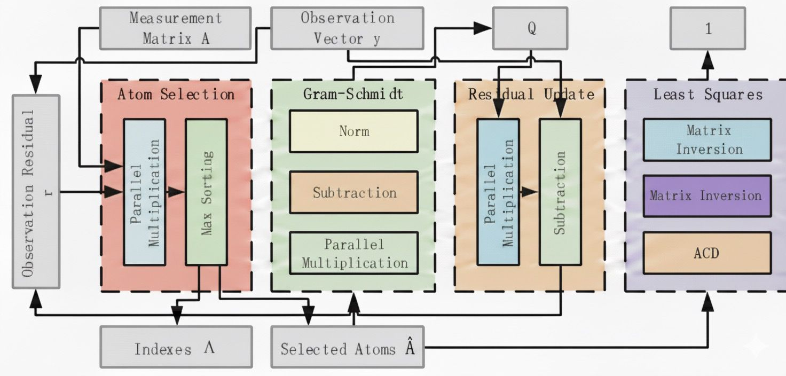
Block diagram
The architecture is divided into 7 main hardware units:
Parallel Multiplication
Multiple multipliers run at the same time.
Vector sum is completed using an adder tree.
Used for inner products and matrix–vector operations.
Max Sorting
After each inner product, compare with current max.
A max register keeps the largest value + index.
Finds the best atom column and stores the index. This way extra memory isn’t used.
Atom Selection Unit
Finds the column (atom) of measurement matrix A that is most correlated with the residual r.
Outputs the index of the best matching atom.

Slide 6
Block Diagram
Gram-Schmidt Unit
Orthogonalizes the selected atoms to produce an orthogonal matrix Q.
Uses parallel multiplication, subtraction and normalization.
Residual Update Unit
Updates the residual using: r_{t} = r_{t-1}- Q_{t} Q_{t}^{T}r_{t-1}
Ensures the new residual is orthogonal to the chosen atoms.
Least-Squares Unit
At the final iteration only, it solves the least-squares problem using Cholesky decomposition.
Produces the final sparse coefficients.
ACD Least-Square
Formula: C⁻¹=(L⁻¹)^{T}D⁻¹L⁻¹
Decomposition of D and L is performed in parallel.
Inversion of L is iterative but pipelined.
Reciprocal of D uses a Goldschmidt-based reciprocal unit, allowing multiple multiplications in parallel.

Slide 7
Work for next week
Develop high-level language implementations of the Orthogonal Matching Pursuit (OMP) and Matching Pursuit (MP) algorithms, and generate a formal Design Requirement Specification (DRS) capturing functional, architectural, and performance constraints.

Slide 8
THANK YOU: Team Muxed Up
Sreyas Janamanchi (IMT2022554)
Margasahayam Venkatesh Chirag (IMT2022583)
Shannon Muthanna I B (IMT2022552)
Vedant Mangrulkar(IMT2022519)
Pradyumna G (IMT2022555)
Chinmay Krishna (IMT2022560)

